Slide 1
Project Title: Development of 8 Comprehensive Playbooks for Cyber Attack Response
Main Objective:
To create a set of 8 specialized playbooks for handling various types of cyberattacks, including phishing and other common attack vectors, to support incident response teams (IRTs) in fast and effective threat mitigation.

Slide 2
Project Idea
Project Summary:
The project focuses on developing 8 playbooks, each tailored to address a specific type of cyberattack.
Each playbook will outline step-by-step response procedures to handle and mitigate these attacks quickly and effectively.
These playbooks will enhance the efficiency of cybersecurity teams in organizations when responding to security incidents.
Importance of Playbooks:
Accelerate the response time of incident teams.
Provide a standardized approach to handling attacks.
Minimize damage and reduce the time window of an attack.

Slide 3
Attack Types Covered by the Project
1. Phishing Attacks
Description: A social engineering attack where the attacker tricks the victim into revealing sensitive information, like passwords or credit card details, through emails or text messages that appear to be from legitimate sources.
Goal: Steal user credentials or sensitive data.
Attack Method: Sending fraudulent messages with malicious links or attachments, designed to prompt users to enter their information.
Response: Identify and block malicious emails, educate users to avoid suspicious links or providing personal information.

Slide 4
Attack Types Covered by the Project
2. Web Attacks
Description: A broad category of attacks targeting web applications, including SQL Injection, Cross-Site Scripting (XSS), and Cross-Site Request Forgery (CSRF).
Goal: Exploit vulnerabilities in web applications to steal data, alter website behavior, or gain unauthorized access.
Attack Methods:
SQL Injection (SQLi): Inserting malicious SQL queries to manipulate databases.
XSS: Injecting malicious scripts into websites to execute in users' browsers.
CSRF: Forcing a user to execute unwanted actions in a web application they are authenticated to.
Response: Implement input validation, sanitize user inputs, and apply security headers.

Slide 5
Attack Types Covered by the Project
3. Distributed Denial of Service (DDoS) Attacks
Description: Attackers overwhelm a target system (website, server, or network) with a flood of requests, causing service unavailability.
Goal: Disrupt services by exhausting server resources (e.g., bandwidth, memory).
Attack Method: Utilizing a botnet (a network of compromised devices) to send massive traffic to a target system.
Response: Use rate limiting, DDoS protection services, and scalable infrastructure to handle large traffic spikes.

Slide 6
Attack Types Covered by the Project
4. Ransomware Attacks
Description: A type of malware that encrypts the victim's files and demands a ransom (often in cryptocurrency) to restore access.
Goal: Extort money from victims by threatening to permanently lock or destroy their data.
Attack Method: Usually spreads via phishing emails or malicious downloads, encrypting important files on the victim's system.
Response: Isolate infected systems, avoid paying the ransom, restore from backups, and employ decryption tools if available.

Slide 7
Attack Types Covered by the Project
5. Malware Attacks
Description: General term for malicious software designed to harm or exploit systems, ranging from viruses and worms to trojans and spyware.
Goal: Damage systems, steal data, or gain unauthorized control of devices.
Attack Method: Malware can be delivered through phishing emails, malicious downloads, or infected devices.
Response: Use antivirus software, regularly update systems, and educate users on safe practices like avoiding suspicious downloads.

Slide 8
Attack Types Covered by the Project
6. Insider Threats
Description: Security risks posed by individuals within the organization who misuse their access to compromise sensitive data or cause harm.
Goal: Leaking sensitive information or sabotaging internal systems.
Attack Method: Privileged users may intentionally or unintentionally access and misuse critical systems or data.
Response: Monitor internal activity, implement role-based access control (RBAC), and train employees on security protocols.

Slide 9
Attack Types Covered by the Project
7. Social Engineering Attacks
Description: Psychological manipulation of individuals to trick them into divulging confidential information, often through communication (phone, email, social media).
Goal: Gain access to systems or sensitive information by exploiting human behavior rather than technical vulnerabilities.
Attack Method: Posing as a legitimate authority figure, gaining trust, and persuading victims to share passwords or confidential data.
Response: Train employees on social engineering tactics and enforce strict identity verification protocols.

Slide 10
Attack Types Covered by the Project
8. Brute Force Attacks
Description: An attack method that tries multiple combinations of usernames and passwords to gain unauthorized access to an account or system.
Goal: Crack passwords or gain unauthorized access to a user’s account.
Attack Method: Automated scripts repeatedly attempt different combinations of credentials until the correct one is found.
Response: Implement account lockout policies, use multi-factor authentication (MFA), and enforce strong password requirements

Slide 11
Playbook Structure
1. Attack Description
Overview: Brief description of the attack and its purpose (e.g., stealing credentials in a phishing attack, disrupting services in a DDoS attack).
Technical Details:
Primary attack method (e.g., malicious link, SQL injection).
Entry points (email, web, network, etc.).
Impact: Potential consequences like data theft, service downtime, or financial loss
2. Indicators of Compromise (IoCs)
Key IoCs: Observable signs of the attack, such as:
Phishing: Suspicious email headers, unexpected links.
DDoS: High traffic from unusual IPs.
Web Attacks: Error messages in web logs, strange database queries.
Detection Tools: Utilize SIEM, IDS/IPS, or log monitoring to flag suspicious activity

Slide 12
Playbook Structure
3. Initial Response Steps (Containment)
Actions:
Isolate the affected systems (disconnect from the network).
Block malicious traffic (firewall updates, IP blocking).
Quarantine or restrict user accounts in case of credential theft.
Communication: Notify internal teams and escalate as needed.
Evidence Collection: Capture logs, screenshots, or traffic data for further analysis
4. Mitigation Steps
Immediate Fixes:
Phishing: Change passwords, block sender domains.
Web Attacks: Patch vulnerabilities, implement input validation.
DDoS: Use traffic filtering services, implement rate-limiting.
System Hardening: Apply patches, secure configurations, and enhance firewalls/WAF settings.
Stakeholder Updates: Keep internal teams informed of progress and system stability

Slide 13
Playbook Structure
5. Full Response Process
Investigation: Analyze logs, network traffic, and systems for further signs of attack or deeper intrusion.
Remediation: Remove malicious files, close security gaps, and verify that systems are clean.
Coordination: Work with legal, PR, and external security teams if the attack impacts customers or regulatory requirements
6. Post-Incident Actions (Recovery & Review)
System Restoration: Ensure systems are restored from backups, validate file integrity, and monitor closely for residual threats.
Report Creation: Document the incident, response steps, and outcomes for future learning.
Root Cause Analysis: Determine how the attack occurred and whether existing defenses were sufficient.
Review & Improve: Update playbooks and processes based on the incident, addressing gaps or slow response times

Slide 14
Playbook Structure
7. Preventative Measures
Security Awareness: Train employees on phishing and attack prevention.
Regular Assessments: Conduct vulnerability scans and penetration tests to identify weaknesses.
Backup Strategy: Test and maintain backups to ensure quick recovery.
Incident Simulations: Practice responses with tabletop exercises or live drill

Slide 15
Key Benefits of the Project
Increased Efficiency:
Improving the speed and effectiveness of incident response.
Damage Control:
Minimizing damage caused by attacks through fast and structured responses.
Flexibility:
Providing flexible response plans that can adapt to the specific nature of the attack.
Compliance with Standards:
Aligning with international cybersecurity standards (e.g., NIST, ISO 27001).
Training Tool:
These playbooks can also serve as a training tool for onboarding and developing security teams.

Slide 16
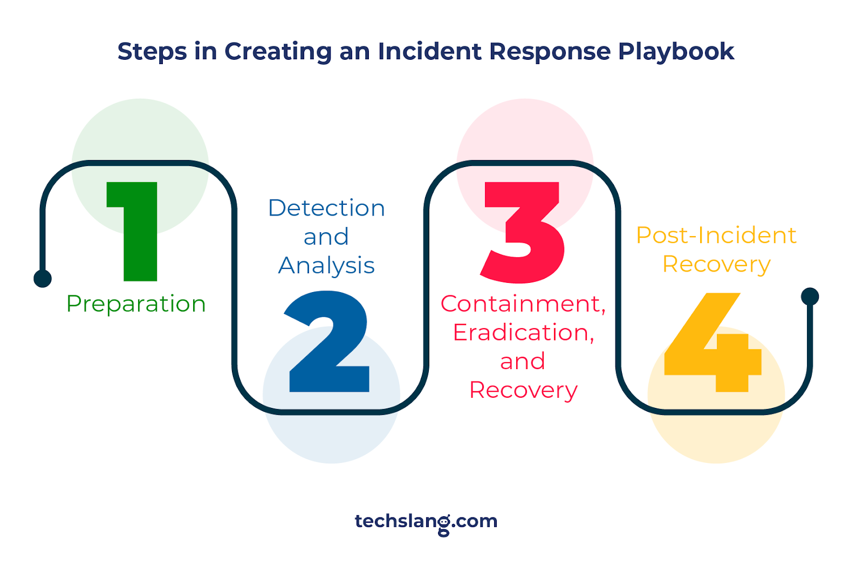
These are the four steps we will deal with in every attack.

Slide 17

Phase 1: Preparation
Goal: Build readiness for handling incidents.
Key Actions:
Form an Incident Response Team (IRT) with defined roles.
Develop an Incident Response Plan (IRP) and playbooks for various attack types.
Set up security tools like SIEM, IDS, and firewalls.
Conduct security awareness training for employees.
Ensure legal and compliance readiness (e.g., GDPR, HIPAA).

Slide 18

Phase 2: Detection & Analysis
Goal: Identify and assess security incidents.
Key Actions:
Monitor systems with SIEM, IDS/IPS, and other tools for suspicious activity.
Analyze Indicators of Compromise (IoCs) like unauthorized logins or unusual traffic.
Conduct initial triage to determine the type and severity of the incident.
Gather evidence and logs for further investigation.

Slide 19

Phase 3: Containment, Eradication & Recovery
Goal: Control and eliminate the threat, and restore systems.
Key Actions:
Containment: Isolate affected systems to prevent the spread of the attack (e.g., lock accounts, block malicious traffic).
Eradication: Remove malware, patch vulnerabilities, and clean infected systems.
Recovery: Restore services from clean backups, verify system integrity, and gradually bring systems back online.

Slide 20

Phase 4: Post-Incident Activities
Goal: Secure the environment and improve defenses.
Key Actions:
Conduct a root cause analysis to understand how the attack occurred.
Update security policies, procedures, and playbooks to address gaps.
Strengthen security controls (e.g., stronger passwords, multi-factor authenticationa

Slide 21


1:Phishing Attack Playbook

Slide 22
Phase 1: Preparation
Objective: Ensure readiness to respond to phishing attacks quickly and efficiently.
Key Actions:
Incident Response Team (IRT):
Define roles for handling phishing incidents, such as security analysts, IT staff, and communications personnel.
Security Tools Setup:
Deploy email filtering systems, anti-phishing tools, and configure SIEM to detect phishing indicators like suspicious email domains and attachments.
Employee Training:
Regularly train employees on how to recognize phishing attempts (e.g., suspicious links, fake login pages).
Incident Response Plan (IRP):
Create detailed response procedures for phishing attacks, including workflows for detecting, analyzing, and containing incidents

Slide 24
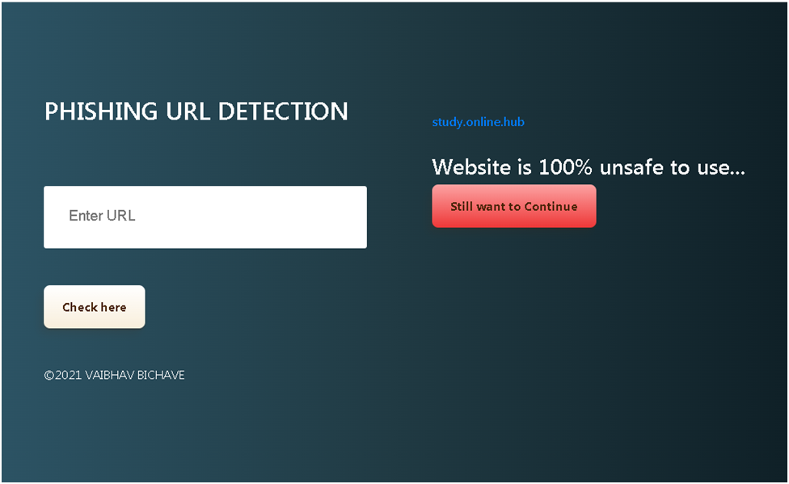
Phase 2: Detection & Analysis
Objective: Identify and assess the phishing attack, determining its scope and impact.
Key Actions:
Detection:
Use SIEM to monitor email traffic for anomalies (e.g., large numbers of emails from unknown domains, unusual attachment types).
Investigate Indicators of Compromise (IoCs) such as suspicious email headers, phishing URLs, or attachments.
Analyze user reports of suspicious emails and check for malicious links or attachments.
Analysis:
Determine the scope of the phishing campaign: who received the email, who clicked on the links, and who entered credentials.
Gather logs from email servers and affected systems using SIEM for deeper analysis (e.g., login attempts from suspicious locations).

Slide 25
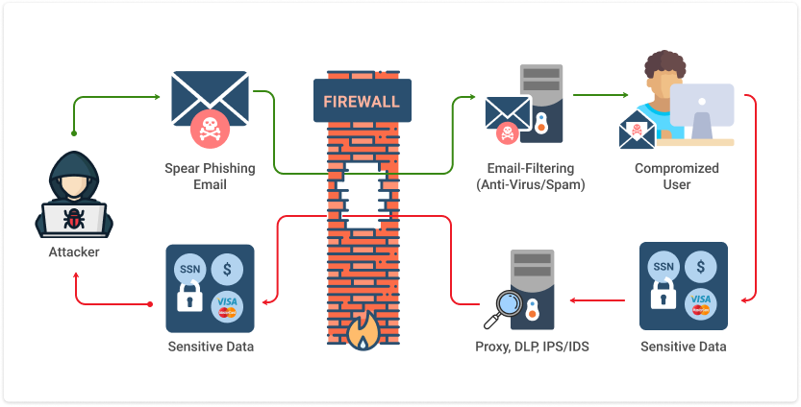

Slide 26
Phase 3: Containment, Eradication & Recovery
Objective: Stop the phishing attack, remove the threat, and restore affected systems.
Key Actions:
Containment:
Lock compromised accounts: Immediately lock and reset passwords for any users who clicked on phishing links or provided credentials.
Block malicious domains: Update email filters and block the phishing domain or URL in firewalls and web proxies.
Quarantine affected emails: Use email server tools to remove phishing emails from users’ inboxes.
Eradication:
Ensure that any malware delivered via attachments is removed from affected systems.
Review affected accounts for any unauthorized access or changes, and verify that there are no residual threats.
Recovery:
Restore access to locked accounts with stronger passwords and enable multi-factor authentication (MFA).
Monitor for any follow-up phishing attempts targeting the same users or systems.
Validate the integrity of systems involved to ensure that no further compromise occurred.

Slide 27


Slide 28
Phase 4: Post-Incident Activities
Objective: Strengthen the organization's defenses and prevent future phishing attacks.
Key Actions:
Root Cause Analysis:
Analyze how the phishing emails bypassed email filtering and how many users were affected.
Identify any gaps in employee training or security tools that contributed to the incident.
Strengthen Security:
Update email filters and improve detection rules within the SIEM to catch similar phishing attempts in the future.
Ensure all employees are using MFA and require strong password policies.
Implement additional security awareness training for employees.
Incident Reporting:
Document the incident, the response, and lessons learned. Share this report with key stakeholders and management.

Slide 29
Phase 5: Lessons Learned
Objective: Use the incident to improve future responses and phishing prevention.
Key Actions:
Post-Incident Review:
Conduct a review meeting with the Incident Response Team to evaluate the effectiveness of the response and identify areas for improvement.
Update the Phishing Playbook with new insights, including IoCs and response steps that proved effective.
Improve Employee Training:
Modify phishing awareness programs to address specific phishing tactics used in the attack.
Refine Tools:
Update SIEM rules and alerts based on the phishing attack characteristics to ensure faster detection next time.
Enhance the email filtering system to block future attacks more effectively.

Slide 30
Conclusion
This Phishing Attack Playbook offers a structured approach to preparing for, detecting, containing, and recovering from phishing attacks. Each phase ensures a comprehensive response that minimizes damage and strengthens the organization’s overall security posture. By continually refining detection methods, such as through SIEM alerts and updated email filters, and educating employees on phishing tactics, the organization can respond to phishing threats swiftly and reduce the likelihood of future incidents.
Through post-incident analysis and lessons learned, the organization gains valuable insights that improve both technical defenses and employee awareness, ensuring a robust defense against phishing attacks.

Slide 31
2:Web Attack Playbook

Slide 32
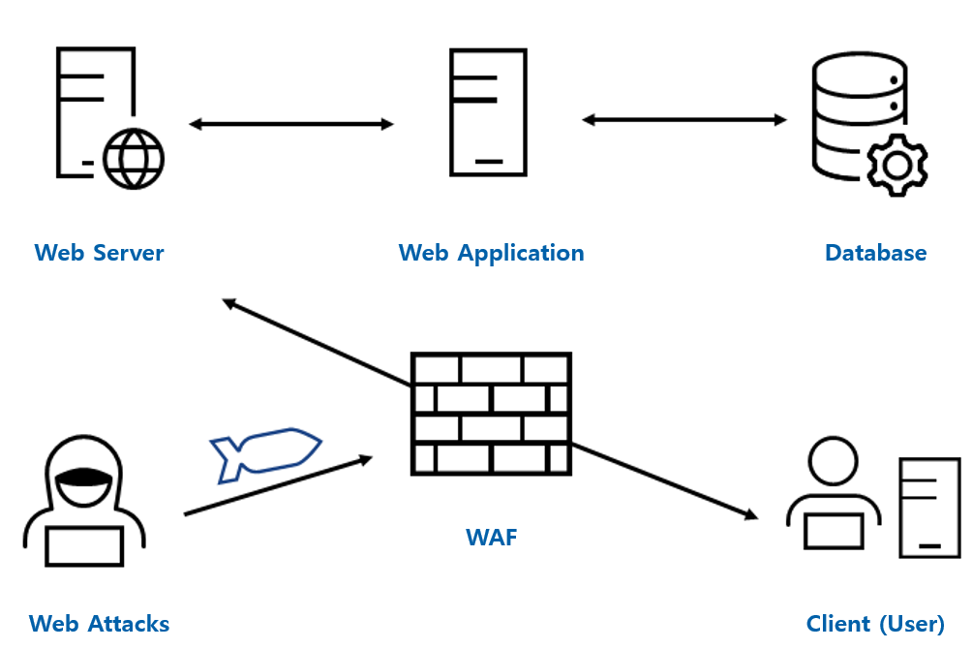
Phase 1: Preparation
Objective: Ensure readiness to detect, contain, and respond to web attacks effectively.
Key Actions:
Incident Response Team (IRT): Assign roles for handling web-based incidents (e.g., web developers, security analysts, IT staff).
Security Tools Setup:
Use a Web Application Firewall (WAF) to block malicious traffic.
Configure SIEM to monitor for suspicious web activity such as abnormal HTTP requests or database queries.
Implement vulnerability scanning and penetration testing regularly to identify weak spots in web applications.
Web Application Hardening:
Follow OWASP Top 10 best practices for securing web applications (e.g., input validation, output encoding, and secure session management).
Ensure regular patching of web servers, databases, and application frameworks.

Slide 33
Phase 2: Detection & Analysis
Objective: Identify the web attack and assess the extent of the compromise.
Key Actions:
Detection:
SIEM and WAF logs can detect suspicious patterns, such as SQL queries in URLs, unexpected POST requests, or XSS injection attempts.
Monitor for Indicators of Compromise (IoCs), such as abnormal database activity, strange user session behavior, or unsanctioned code execution on servers.
Analysis:
Identify which web application or endpoint is being exploited (e.g., SQL Injection in a login form, XSS via user comments).
Determine the scope of the attack: which users, databases, or web services are affected.
Review web server and application logs to trace the attacker’s activity and determine the attack vector.

Slide 34
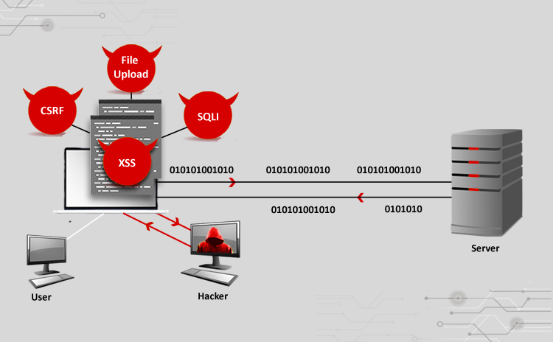

Slide 35
Phase 3: Containment, Eradication & Recovery
Objective: Stop the web attack, remove the threat, and restore affected systems to secure operations.
Key Actions:
Containment:
Isolate vulnerable endpoints: Temporarily disable the compromised web page or feature (e.g., login form or comments section) to prevent further exploitation.
Block malicious traffic: Use the WAF to block offending IP addresses or HTTP requests attempting to exploit vulnerabilities.
Lock compromised accounts: If the attack involved user accounts (e.g., session hijacking via XSS), lock those accounts and reset passwords.
Eradication:
Patch vulnerabilities: For SQLi, sanitize all inputs and use prepared statements. For XSS, apply input validation and output encoding.
Remove malicious scripts: For XSS, remove injected scripts and clean any compromised data from the database.
Secure code: Apply security patches to the web server or application and close any backdoors created by the attacker.
Recovery:
Restore web services gradually, ensuring the vulnerability has been patched and the system is stable.
Use SIEM and WAF to monitor for further suspicious activity or attempted attacks.
Validate the integrity of databases and web applications to ensure no unauthorized changes were made.

Slide 36
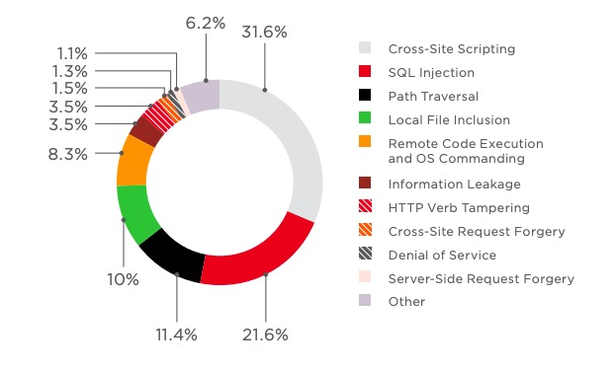

Slide 37
Phase 4: Post-Incident Activities
Objective: Strengthen security by analyzing the root cause of the attack and applying additional safeguards.
Key Actions:
Root Cause Analysis:
Identify how the attack bypassed security controls (e.g., SQLi exploit due to unsanitized input, XSS through unencoded data).
Determine if any gaps in monitoring or detection allowed the attack to persist undetected for too long.
Strengthen Security:
Implement stricter input validation rules and use secure coding practices across all web applications.
Update SIEM and WAF rules to detect similar attack patterns in the future.
Conduct a thorough security review of the web application and apply necessary patches or configuration changes.
Incident Reporting:
Document the attack timeline, how it was detected, and the actions taken to resolve it. Share findings with stakeholders.

Slide 39
Lessons Learned
Objective: Use the incident as an opportunity to improve response capabilities and web security.
Key Actions:
Post-Incident Review:
Hold a review meeting with the Incident Response Team to evaluate the response and identify areas for improvement.
Update the Web Attack Playbook with new information and adjustments based on the attack characteristics and response efforts.
Training and Awareness:
Train developers on secure coding practices and update them on vulnerabilities like SQLi, XSS, and CSRF.
Refine Tools:
Update SIEM rules and WAF signatures to better detect web-based threats in the future.
Ensure that vulnerability scanning and penetration testing are done more frequently to catch potential weaknesses early.

Slide 40
Conclusion
This Web Attack Playbook offers a clear and structured approach to handling web-based attacks such as SQL Injection, XSS, and CSRF. It focuses on preparing the organization with the right tools (e.g., SIEM, WAF) and processes for detecting, containing, and eradicating web attacks. Each phase of the playbook ensures a swift and effective response, minimizing damage and preventing future incidents.
By continually analyzing incidents and refining detection methods, organizations can improve their ability to handle web attacks. This playbook ensures that technical vulnerabilities are addressed while also improving the Incident Response Team's ability to respond to evolving threats in web applications.

Slide 41

3:DDoS Attack Playbook

Slide 42
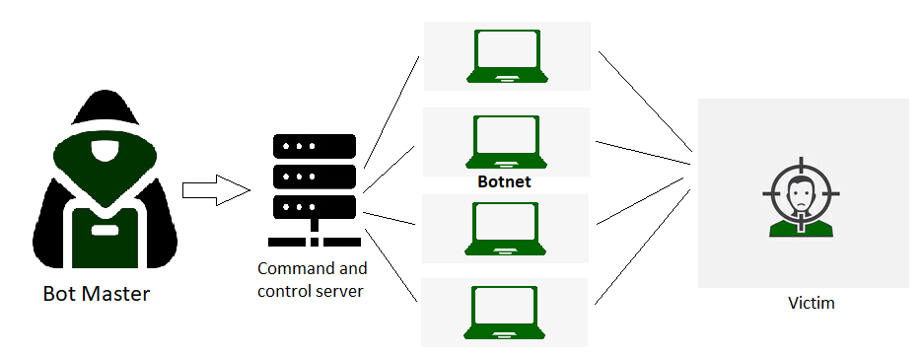
Phase 1: Preparation
Objective: Ensure that the organization is ready to detect and mitigate DDoS attacks before they cause significant disruption.
Key Actions:
Incident Response Team (IRT): Assign roles within the IRT for handling DDoS incidents, including network administrators and security analysts.
DDoS Protection Services:
Use cloud-based DDoS mitigation services (e.g., Cloudflare, Akamai, AWS Shield) that can absorb and filter out malicious traffic before it reaches your servers.
Implement rate-limiting and traffic filtering rules at firewalls and routers.
Monitoring and Detection Tools:
Set up SIEM, Intrusion Detection Systems (IDS), and traffic monitoring tools to detect abnormal traffic spikes and patterns typical of DDoS attacks.
Incident Response Plan (IRP): Develop detailed procedures for detecting, containing, and recovering from DDoS attacks, ensuring that roles and actions are clearly defined.

Slide 43
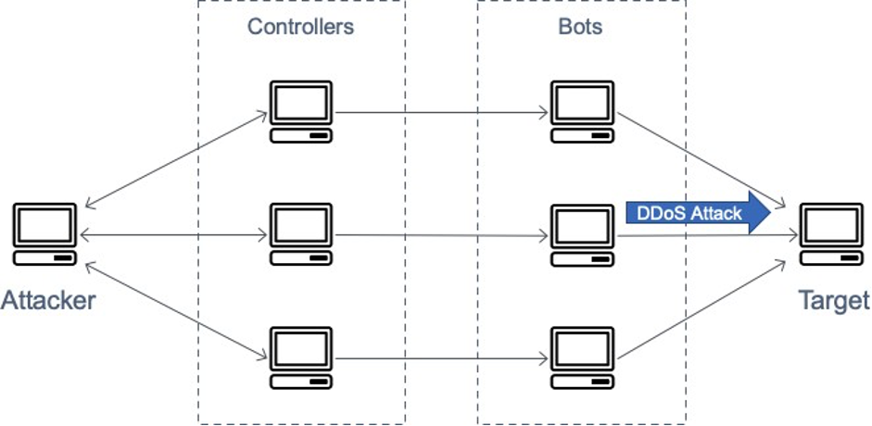

Slide 44
Phase 2: Detection & Analysis
Objective: Identify the DDoS attack early and understand the scope and type of attack to respond effectively.
Key Actions:
Detection:
SIEM and traffic monitoring tools can alert the team to abnormal spikes in network traffic or bandwidth usage, indicating a potential DDoS attack.
Identify Indicators of Compromise (IoCs), such as:
Unusually high traffic from multiple IPs or locations (botnet traffic).
Decreased service performance (slow response times, downtime).
Analysis:
Determine the type of DDoS attack (e.g., volumetric, application-layer, protocol-based).
Assess the attack volume and impact: How much traffic is being generated? Which services are affected? Are any critical systems down?
Use logs and traffic analysis tools to trace the attack's origin and identify patterns (e.g., repeating IP addresses or countries).

Slide 45
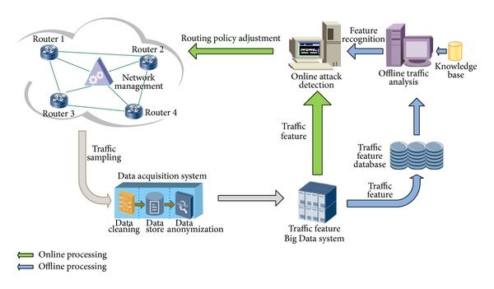

Slide 46
Phase 3: Containment, Eradication & Recovery
Objective: Contain the DDoS attack, reduce its impact, and restore normal operations as quickly as possible.
Key Actions:
Containment:
Engage DDoS protection services to filter out malicious traffic at the network edge or cloud layer.
Rate-limiting: Apply rate limits at the firewall or load balancer to limit the number of requests allowed per IP.
Block IP addresses: Identify and block traffic from known malicious IP addresses or geographic regions if the attack is concentrated.
Traffic filtering: Use Web Application Firewalls (WAF) to block malicious traffic targeting specific application layers (e.g., HTTP flood attacks).
Eradication:
Work with your DDoS mitigation provider to continue filtering and reducing the attack’s intensity.
Remove any compromised internal systems (e.g., servers or IoT devices) that may have been used to amplify the attack.
Recovery:
Gradually restore services once the attack subsides and traffic levels return to normal.
Monitor traffic closely during recovery to detect any resurgence of the attack.
Ensure critical systems (e.g., websites, APIs) are fully operational and responsive.
Communicate with key stakeholders, customers, and users about service restoration

Slide 47
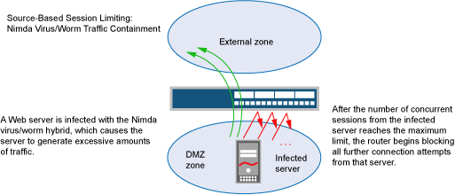

Slide 48
Phase 4: Post-Incident Activities
Objective: Strengthen network defenses and prevent future DDoS attacks by analyzing how the attack occurred and what weaknesses were exploited.
Key Actions:
Root Cause Analysis:
Identify the source of the attack (e.g., botnet, amplification technique) and understand why the attack was able to affect your services (e.g., lack of traffic filtering, insufficient bandwidth).
Determine the weaknesses in your network infrastructure or mitigation processes that need improvement.
Strengthen Security:
Improve network architecture by adding additional layers of DDoS protection, increasing bandwidth, or deploying more robust load balancers.
Update SIEM and firewall rules to better detect and block abnormal traffic patterns early.
Incident Reporting:
Document the attack, including its type, duration, volume of traffic, and impact. This should include steps taken to mitigate the attack and recover services.
Share the incident report with management and key stakeholders to inform future decision-making and preparedness

Slide 49
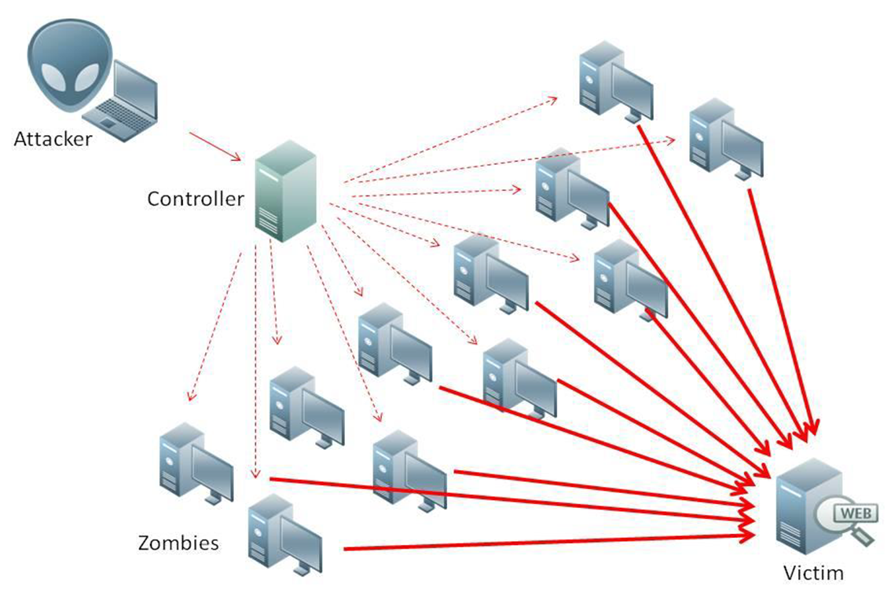

Slide 50
Lessons Learned
Objective: Use the insights from the DDoS attack to improve future response capabilities and prevent similar incidents.
Key Actions:
Post-Incident Review:
Conduct a post-mortem meeting with the IRT to evaluate the incident response. Discuss what worked well, what didn’t, and what could be improved.
Review the effectiveness of DDoS protection services, WAF configurations, and SIEM alerts in detecting and mitigating the attack.
Update Playbook:
Revise the DDoS Attack Playbook to incorporate any new best practices, IoCs, or response strategies learned during the incident.
Refine Tools:
Update SIEM detection rules to improve early detection of DDoS activity.
Improve the load balancing and rate-limiting rules based on the type and scale of the attack.

Slide 51
Conclusion
This DDoS Attack Playbook offers a structured response to mitigating, containing, and recovering from Distributed Denial of Service attacks. With strong preparation, early detection via SIEM and traffic monitoring, and robust containment measures such as cloud-based DDoS mitigation and rate-limiting, organizations can reduce the damage caused by such attacks.
The final phases focus on analyzing the attack, identifying gaps in network architecture, and improving defenses for future attacks. By refining response processes and tools, organizations can increase their resilience against DDoS attacks and ensure continuous service availability for users and customers.

Slide 52
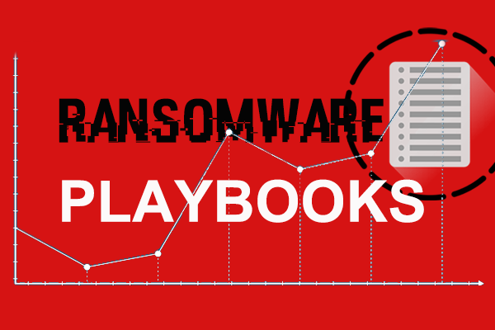
4:Ransomware Attack Playbook

Slide 53
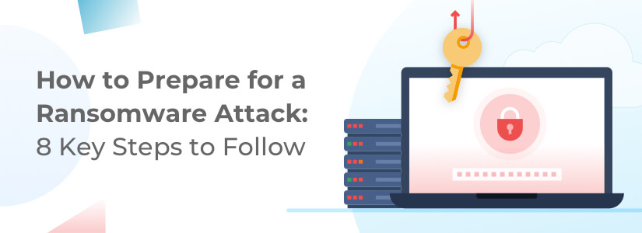

Slide 54
Phase 1: Preparation
Objective: Ensure readiness to prevent, detect, and respond to ransomware attacks efficiently.
Key Actions:
Incident Response Team (IRT): Define roles for handling ransomware incidents, including IT, security teams, legal, and communications.
Backup Strategy:
Implement a robust backup solution that maintains offline, encrypted, and regular backups of critical data.
Ensure backup systems are segmented from the main network to prevent ransomware from spreading to them.
Security Tools Setup:
Deploy endpoint protection, anti-malware solutions, and configure SIEM to detect suspicious file changes, encryption patterns, or unauthorized access to systems.
Regularly update all software, including operating systems and applications, to patch known vulnerabilities.
Employee Awareness:
Conduct security awareness training on recognizing phishing emails, malicious attachments, and suspicious websites.
Train staff on how to report potential ransomware attacks immediately.

Slide 55


Slide 56
Phase 2: Detection & Analysis
Objective: Detect the ransomware attack early and assess the extent of the compromise.
Key Actions:
Detection:
Use SIEM, endpoint detection and response (EDR) tools, and anti-malware solutions to monitor for:
Unusual file encryption activities.
Abnormal file access patterns (e.g., massive file modifications or renaming).
Unauthorized access to critical servers or shared folders.
Suspicious processes running that could indicate ransomware.
Indicators of Compromise (IoCs) include:
Ransom notes appearing on systems.
Files with unusual extensions (e.g., .locked, .crypt).
Users unable to access their files or systems.
Analysis:
Determine which systems are affected and the extent of the damage.
Analyze the ransomware variant (e.g., WannaCry, Ryuk, etc.) using threat intelligence databases to understand its behavior.
Investigate how the ransomware entered the network (e.g., phishing email, drive-by download, or exploited vulnerability).

Slide 58
Phase 3: Containment, Eradication & Recovery
Objective: Stop the spread of ransomware, remove the infection, and restore systems to full functionality.
Key Actions:
Containment:
Isolate infected systems: Disconnect affected devices from the network to prevent ransomware from spreading to other systems.
Disable compromised accounts: If credentials are compromised, disable affected user accounts.
Block command-and-control (C2) communications: Use firewalls and SIEM to block outbound traffic to suspicious IP addresses associated with ransomware.
Eradication:
Remove ransomware: Use anti-malware and endpoint security tools to clean ransomware from infected systems.
Identify the attack vector (e.g., phishing, vulnerability) and patch the vulnerability or close the entry point.
Perform a full forensic analysis to ensure all traces of ransomware and its footholds are eliminated.
Recovery:
Restore systems from clean backups: Only restore from offline backups that were not compromised by the ransomware.
Validate data integrity: Ensure that restored systems and data are clean and functional before reconnecting to the network.
Gradually reconnect systems to the network and closely monitor for any signs of residual ransomware activity.

Slide 59
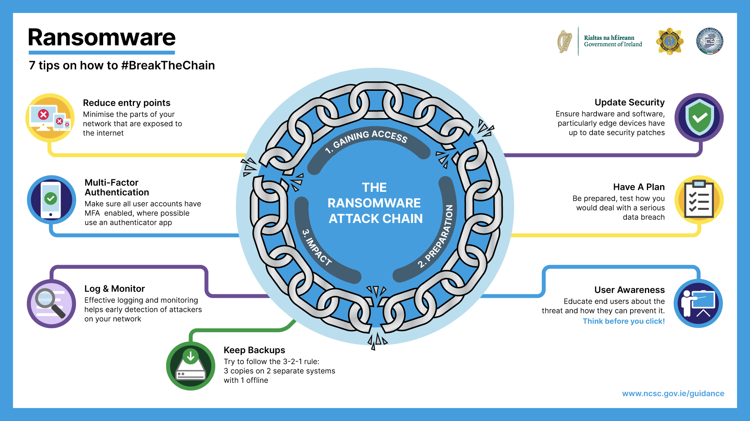

Slide 60
Phase 4: Post-Incident Activities
Objective: Strengthen defenses by understanding how the ransomware attack occurred and making improvements to prevent future incidents.
Key Actions:
Root Cause Analysis:
Investigate how the ransomware gained entry into the network (e.g., phishing, software vulnerability, weak password).
Identify the security gaps that allowed the ransomware to execute (e.g., lack of patching, no segmentation of backups).
Strengthen Security:
Apply stronger email filters and endpoint protection settings to block malicious emails and attachments.
Enforce stricter access controls and implement multi-factor authentication (MFA) to reduce the risk of account compromise.
Increase network segmentation and ensure that backups are isolated from the main network.
Incident Reporting:
Document the ransomware attack, including how it was detected, the scope of the damage, and how it was resolved.
Share the incident report with relevant stakeholders, including management, legal, and regulatory authorities (if applicable).

Slide 61


Slide 62
Lessons Learned
Objective: Improve future ransomware detection, response capabilities, and prevention measures.
Key Actions:
Post-Incident Review:
Hold a post-mortem meeting with the Incident Response Team to assess the effectiveness of the response.
Discuss what worked well (e.g., detection speed, containment) and areas for improvement (e.g., backup restoration time).
Update Playbook:
Incorporate new Indicators of Compromise (IoCs), ransomware variants, and response techniques into the Ransomware Playbook.
Enhance response procedures based on lessons learned to ensure faster containment and recovery in future incidents.
Refine Tools and Processes:
Update SIEM rules to detect ransomware activity earlier (e.g., detecting encryption at early stages).
Improve backup strategies to ensure frequent, reliable backups with quick restoration capabilities.
Employee Training:
Conduct additional training focused on how ransomware enters organizations, with emphasis on email security and phishing prevention.

Slide 63
Conclusion
This Ransomware Attack Playbook provides a step-by-step approach to preparing for, detecting, containing, and recovering from ransomware attacks. By implementing strong prevention measures (e.g., backup strategies, MFA, email filtering), deploying robust detection tools (e.g., SIEM, EDR), and having a clear response plan in place, organizations can significantly reduce the damage caused by ransomware.
Each phase ensures that the attack is contained and eliminated as quickly as possible, with systems and data restored from clean backups. Finally, the lessons learned phase emphasizes the importance of post-incident analysis and continuous improvement to strengthen defenses against future attacks.

Slide 64
5:Malware Attack Playbook

Slide 65
Phase 1: Preparation
Objective: Ensure readiness to prevent, detect, and respond to malware incidents.
Key Actions:
Incident Response Team (IRT): Define roles for handling malware incidents, including security analysts, IT staff, and network engineers.
Security Tools Setup:
Deploy endpoint protection, anti-malware solutions, and firewalls across all systems.
Configure SIEM to monitor for malware-related Indicators of Compromise (IoCs), such as unauthorized system access, suspicious processes, or changes in file integrity.
Patch Management:
Implement a patch management program to ensure operating systems, applications, and software are updated regularly to prevent exploitation by malware.
Employee Awareness:
Train employees to recognize phishing emails and malicious downloads, as these are common vectors for malware.
Backup Strategy:
Ensure regular, offline, and segmented backups to recover systems in case of malware attacks, such as ransomware.

Slide 66
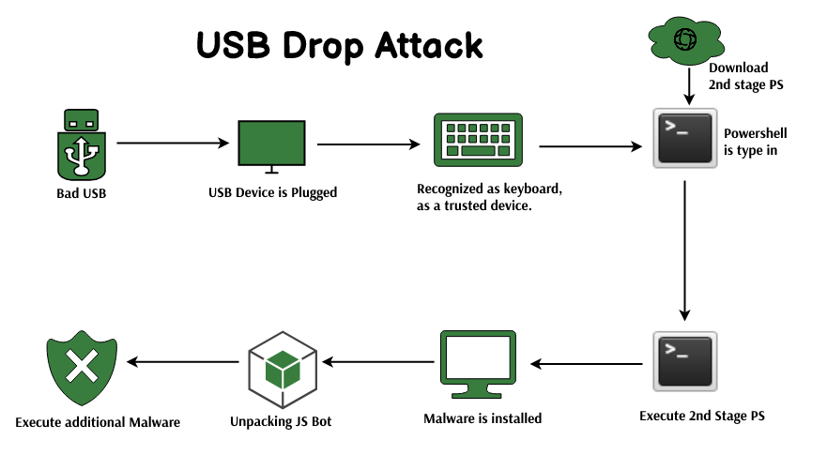

Slide 67
Phase 2: Detection & Analysis
Objective: Identify the malware infection and analyze its scope and behavior.
Key Actions:
Detection:
Use SIEM, endpoint detection and response (EDR) tools, and anti-malware software to detect unusual activities like:
Unrecognized processes running in the background.
Unauthorized file modifications or access attempts.
Infected systems trying to connect to malicious command-and-control (C2) servers.
Sudden performance degradation or suspicious network activity.
Indicators of Compromise (IoCs) include:
Unusual executable files.
Suspicious IP addresses or domains.
Changes in file names or extensions.
Analysis:
Identify the type of malware (e.g., virus, trojan, ransomware) through malware analysis and by consulting threat intelligence sources.
Determine which systems and data are affected, and assess the potential impact (e.g., data loss, system downtime).
Investigate how the malware entered the system (e.g., phishing email, drive-by download, or malicious USB).

Slide 69
Phase 3: Containment, Eradication & Recovery
Objective: Isolate the malware, remove it from the system, and restore affected systems.
Key Actions:
Containment:
Isolate infected systems: Disconnect compromised devices from the network to prevent further spread of the malware.
Quarantine infected files: Use anti-malware solutions to quarantine or delete malicious files.
Block malicious IPs and domains: Update firewall and SIEM rules to block outbound traffic to command-and-control (C2) servers associated with the malware.
Eradication:
Run comprehensive malware scans across all potentially affected systems to ensure no malware remnants are left behind.
Patch vulnerabilities: Close any vulnerabilities (e.g., software exploits, unpatched systems) that the malware used to enter or spread through the network.
Remove malicious files: Use endpoint detection tools to remove any residual malware or backdoors left on systems.
Recovery:
Restore systems from clean backups: Ensure that infected systems are restored to a safe, clean state.
Verify the integrity of restored data and ensure that all malware has been removed before reconnecting systems to the network.
Gradually re-enable services while closely monitoring for any further signs of compromise.

Slide 70
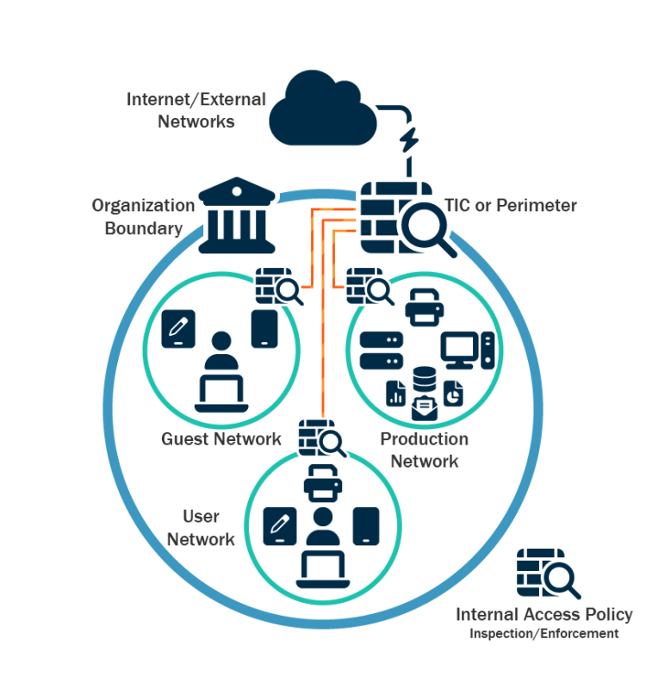

Slide 71
Phase 4: Post-Incident Activities
Objective: Strengthen security and ensure the malware attack cannot be repeated.
Key Actions:
Root Cause Analysis:
Investigate how the malware entered the network (e.g., phishing, unpatched system) and identify the security gaps that were exploited.
Determine why the malware was able to execute successfully (e.g., lack of security updates, insufficient endpoint protection).
Strengthen Security:
Apply patches to any vulnerabilities found during the investigation.
Update anti-malware definitions and enhance endpoint detection capabilities.
Increase network segmentation to limit the spread of future malware infections.
Incident Reporting:
Document the malware incident, including how it was detected, the scope of the infection, and steps taken to contain and eradicate it.
Share the incident report with key stakeholders, including IT management and legal teams (if needed for compliance).

Slide 72
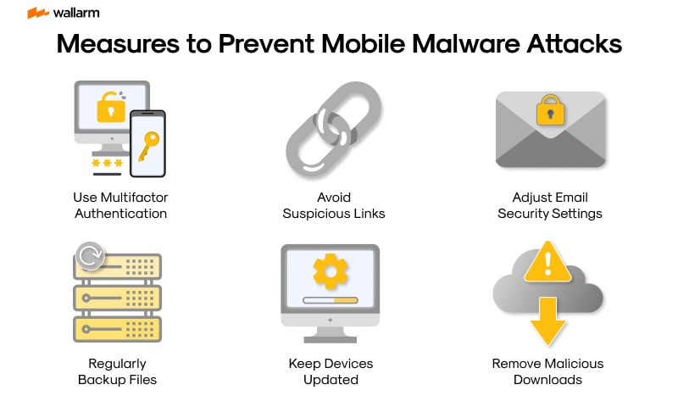

Slide 73
Lessons Learned
Objective: Use the malware incident as an opportunity to improve future detection and prevention capabilities.
Key Actions:
Post-Incident Review:
Hold a post-mortem meeting with the Incident Response Team to evaluate the effectiveness of the response.
Discuss what worked well (e.g., detection speed, eradication efforts) and identify areas for improvement (e.g., faster containment, better endpoint monitoring).
Update Playbook:
Incorporate new Indicators of Compromise (IoCs), malware variants, and response techniques into the Malware Attack Playbook.
Ensure any improvements to detection, containment, and response are documented for future incidents.
Refine Tools and Processes:
Update SIEM rules and anti-malware software to better detect similar malware activity in the future.
Enhance backup strategies to ensure quick recovery in case of future malware infections.
Employee Training:
Provide additional security awareness training to staff, particularly focused on how malware can enter the network (e.g., phishing emails, malicious downloads).
Emphasize the importance of reporting suspicious activities and files.

Slide 74
Conclusion
This Malware Attack Playbook provides a structured response for handling malware infections, from detection to recovery. By preparing with strong endpoint protection, SIEM, and backup strategies, organizations can minimize the impact of malware incidents. Detection tools play a critical role in identifying malware early, and the response process ensures that infections are quickly contained, removed, and systems are restored to their normal state.
Through lessons learned, the playbook ensures continuous improvement of defenses, enabling faster responses and better protection against future malware attacks. This approach will help minimize damage, reduce downtime, and improve overall cybersecurity resilience against evolving malware threats.

Slide 75

6:Insider Threat Playbook

Slide 76
Phase 1: Preparation
Objective: Ensure the organization is prepared to detect and mitigate insider threats effectively.
Key Actions:
Incident Response Team (IRT): Define roles within the IRT for handling insider threats, including HR, IT, legal, and security personnel.
Access Controls:
Implement role-based access control (RBAC) to ensure employees have access only to the resources they need.
Enforce least privilege principles and limit administrative access.
Monitoring Tools Setup:
Configure SIEM, User and Entity Behavior Analytics (UEBA), and Data Loss Prevention (DLP) systems to detect abnormal user behavior, data access, and file transfers.
Security Policies and Procedures:
Develop strict policies for data handling, acceptable use, and access to sensitive information.
Establish a clear onboarding and offboarding process to manage access for new employees and remove access for departing employees.
Employee Training:
Regularly train employees on security policies, data protection, and the risks of insider threats.
Promote a whistleblower policy that encourages reporting suspicious behavior.

Slide 77
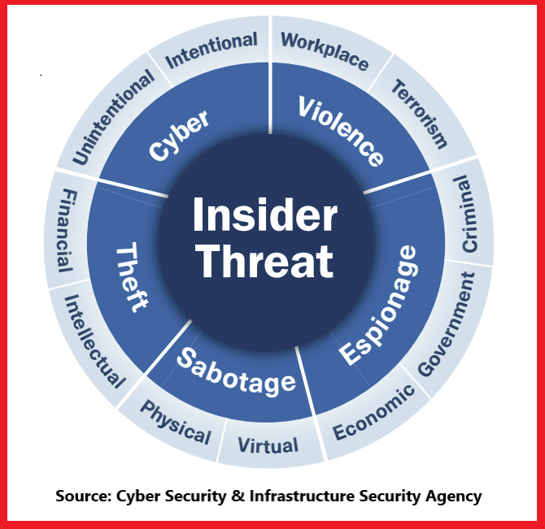

Slide 78
Phase 2: Detection & Analysis
Objective: Identify potential insider threats early and assess their scope and impact.
Key Actions:
Detection:
Use SIEM and UEBA tools to monitor for suspicious activities such as:
Unusual data access patterns (e.g., accessing sensitive files not related to the user’s role).
Large file downloads or unauthorized transfers.
Unauthorized access to restricted systems or data.
Abnormal working hours or behavior, such as access attempts late at night or on weekends.
Indicators of Compromise (IoCs):
Data exfiltration attempts (e.g., copying files to external drives or cloud services).
Employees attempting to access systems outside their job role.
Sudden changes in employee behavior or performance (e.g., after being placed under disciplinary review).
Analysis:
Investigate the behavior flagged by detection systems. Is it potentially malicious, or could it be explained by legitimate work activity?
Identify the insider’s access level, the systems or data involved, and any potentially compromised assets.
Conduct a deeper audit of logs and data access patterns to understand the extent of the suspicious activity.

Slide 79
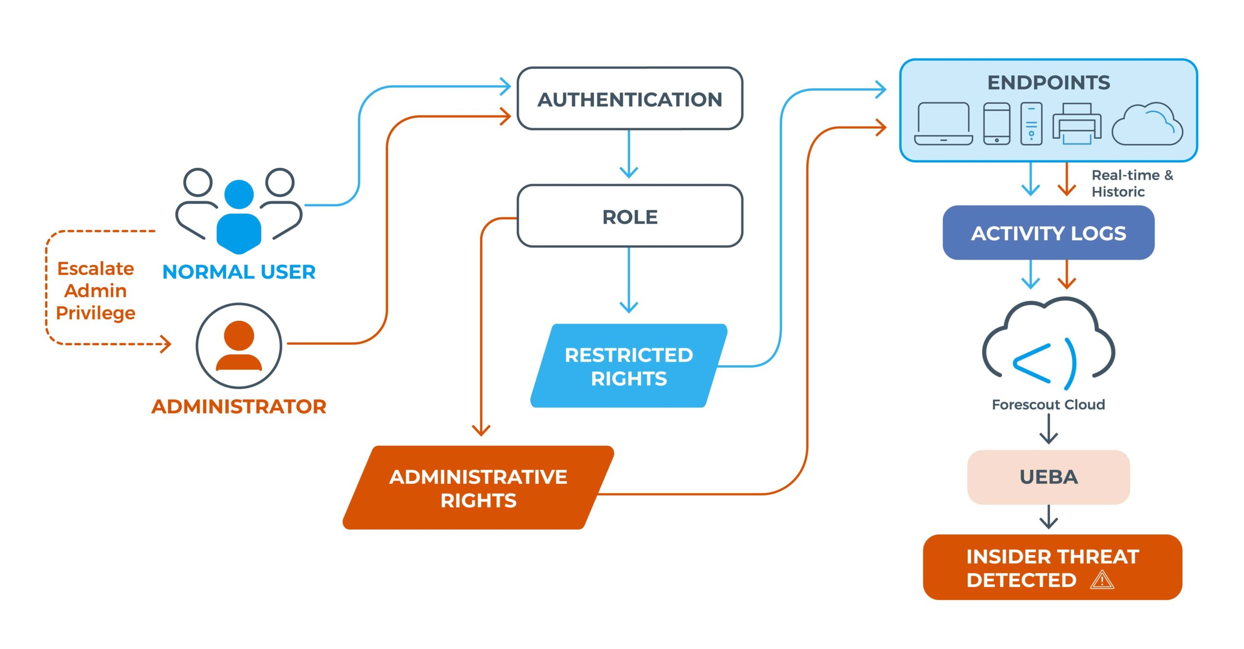

Slide 80
Phase 3: Containment, Eradication & Recovery
Objective: Contain the threat, stop further damage, and restore any compromised systems or data.
Key Actions:
Containment:
Limit the user’s access: Temporarily suspend or reduce the employee’s access to sensitive systems or data if malicious intent is suspected.
Monitor closely: In cases where immediate suspension is not appropriate, intensify monitoring of the user’s activity using SIEM, UEBA, and DLP.
Quarantine compromised systems: If the insider has already accessed or modified critical systems, isolate those systems to prevent further misuse.
Eradication:
Remove unauthorized access and privileges from the suspected insider.
Change passwords, access tokens, or security credentials on systems the insider had access to.
Review and close any vulnerabilities that allowed the insider to escalate privileges or bypass controls.
Recovery:
If data was deleted, altered, or exfiltrated, restore it from clean backups.
Validate the integrity of systems and databases the insider had access to.
Resume normal access to systems after ensuring all malicious activity has stopped and appropriate controls have been implemented.

Slide 82
Phase 4: Post-Incident Activities
Objective: Strengthen security measures by addressing the weaknesses that allowed the insider threat to occur.
Key Actions:
Root Cause Analysis:
Investigate the cause of the insider threat. Was it triggered by personal motives (e.g., revenge, financial gain), or was it accidental?
Identify weaknesses in the access control or monitoring systems that allowed the insider to misuse their access.
Strengthen Security:
Implement stricter access controls and least privilege policies.
Apply additional behavioral monitoring using UEBA to flag early signs of abnormal behavior.
Improve the offboarding process to ensure that former employees or contractors cannot retain access to sensitive systems.
Incident Reporting:
Document the incident, how it was detected, actions taken, and the impact on the organization.
Report the findings to management and legal if necessary, especially in cases of data breaches or regulatory compliance violations.

Slide 83
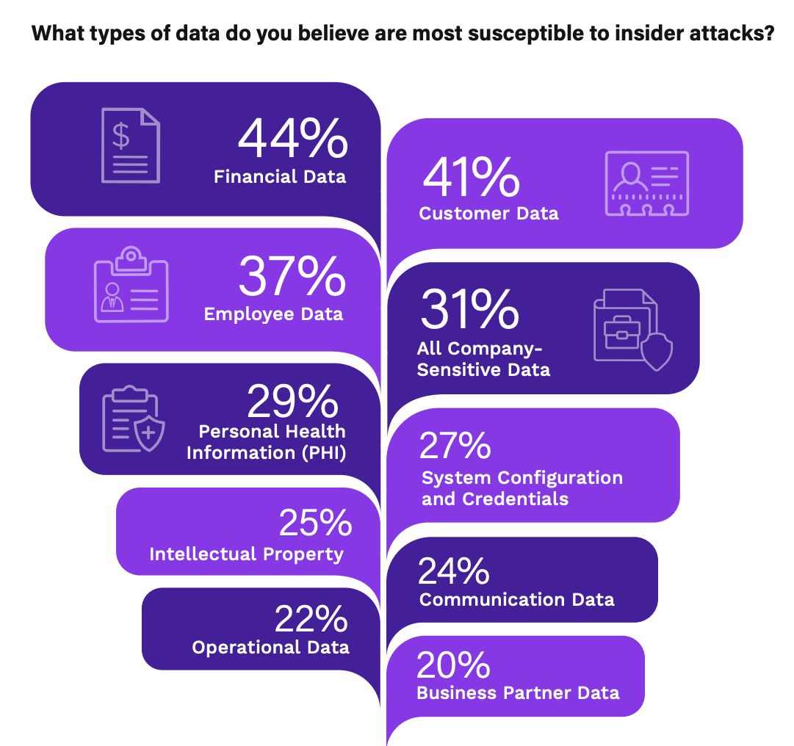

Slide 84
Lessons Learned
Objective: Improve response to insider threats by learning from the incident and updating security protocols.
Key Actions:
Post-Incident Review:
Conduct a post-mortem with HR, IT, security teams, and legal to evaluate the incident response.
Discuss what worked well (e.g., detection methods, rapid containment) and what could be improved (e.g., earlier detection, stronger access controls).
Update Playbook:
Add new Indicators of Compromise (IoCs) and response strategies to the Insider Threat Playbook to ensure faster detection and response in the future.
Refine Tools and Processes:
Update SIEM, DLP, and UEBA systems to improve detection of suspicious insider behavior.
Implement periodic privilege reviews to ensure employees only have the necessary access to perform their roles.
Employee Awareness:
Conduct additional security training focused on insider threats and data protection.
Emphasize the importance of reporting suspicious behavior and ensuring compliance with data access policies.

Slide 85
Conclusion
This Insider Threat Playbook provides a structured approach to managing the risks associated with trusted individuals who may misuse their access to sensitive systems or data. The playbook emphasizes robust preparation, including access controls, employee training, and behavioral monitoring through tools like SIEM and UEBA.
Detection systems identify abnormal behaviors early, and rapid containment ensures that the insider’s access is restricted before significant damage can occur. The final phases focus on improving security controls, learning from the incident, and updating tools to prevent future insider threats. By continually improving processes, organizations can reduce the risk of insider attacks and protect their most critical assets.

Slide 86

7:Social Engineering Attack Playbook

Slide 87
Phase 1: Preparation
Objective: Ensure the organization is equipped to detect, prevent, and respond to social engineering attacks effectively.
Key Actions:
Incident Response Team (IRT): Assign roles for managing social engineering incidents, including security teams, IT, communications, and HR.
Employee Awareness Training:
Regularly train employees on social engineering tactics, such as phishing, vishing, and baiting.
Include simulations of phishing attacks to improve awareness and train staff on how to respond.
Security Policies and Procedures:
Implement and enforce strict policies regarding information sharing and communication (e.g., verifying identities before sharing sensitive information).
Use two-factor authentication (2FA) for sensitive systems and data access to reduce the impact of credential theft.

Slide 88

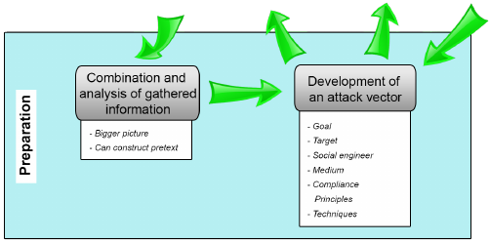

Slide 89
Phase 2: Detection & Analysis
Objective: Identify the social engineering attack early and assess its scope and potential damage.
Key Actions:
Detection:
Use SIEM and email filtering tools to detect indicators of social engineering attempts, such as:
Emails with suspicious links, urgent requests for personal information, or attachments.
Unusual login attempts or access from unexpected locations.
Reports from employees about unusual requests for information (e.g., phone calls pretending to be from IT or management).
Indicators of Compromise (IoCs) include:
Phishing emails or vishing calls asking for login credentials, personal details, or financial information.
Unusual requests for privileged access or sensitive data that do not follow typical processes.
Analysis:
Investigate how the social engineering attack is being carried out (e.g., phishing email, pretexting call).
Identify which individuals or departments are being targeted and determine if any sensitive information has been compromised.
Assess whether employees have responded to the attack (e.g., clicked on a phishing link, provided sensitive details).

Slide 91
Phase 3: Containment, Eradication & Recovery
Objective: Stop the social engineering attack, limit damage, and restore affected systems.
Key Actions:
Containment:
Lock compromised accounts: Immediately lock accounts that have been compromised (e.g., if a user clicked on a phishing link and entered credentials).
Block malicious domains and emails: Use email filtering to block the sender’s domain and update firewalls to block any associated IP addresses or malicious links.
Quarantine affected systems: If malware or remote access tools have been downloaded through a social engineering attack, isolate infected systems.
Employee notification: Alert employees of the ongoing social engineering attack and provide guidance on how to respond.
Eradication:
Remove malware: If any malicious software was downloaded as part of a phishing or baiting attack, remove it using endpoint protection tools.
Change compromised credentials: Reset passwords for affected accounts and enforce the use of multi-factor authentication (MFA).
Conduct further investigation: Perform a deeper forensic investigation to ensure no further compromises were made and to check for unauthorized access or backdoors.
Recovery:
Restore compromised systems: Ensure any systems affected by malware or unauthorized access are restored from clean backups.
Re-enable employee accounts once they have been secured and monitored for further suspicious activity.

Slide 92
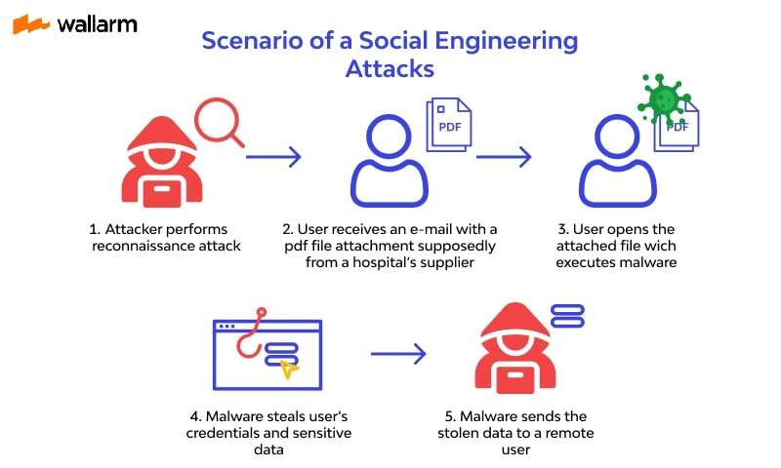

Slide 93
Phase 4: Post-Incident Activities
Objective: Strengthen security by learning from the social engineering incident and applying additional safeguards.
Key Actions:
Root Cause Analysis:
Identify how the social engineering attack succeeded (e.g., phishing email bypassed filters, employee fell for a vishing attack).
Determine any security gaps that allowed the attacker to succeed, such as a lack of awareness or poor email filtering rules.
Strengthen Security:
Improve email filtering and adjust SIEM rules to detect social engineering attacks more effectively.
Update security policies around identity verification and sensitive data sharing, particularly for high-risk employees or departments (e.g., HR, finance).
Implement user training to ensure employees know how to respond to suspicious emails, calls, or other communication requests.
Incident Reporting:
Document the attack in detail, including the timeline of events, impact on systems and data, and how the organization responded.
Share the incident report with relevant stakeholders, including management, HR, and legal if necessary.

Slide 94
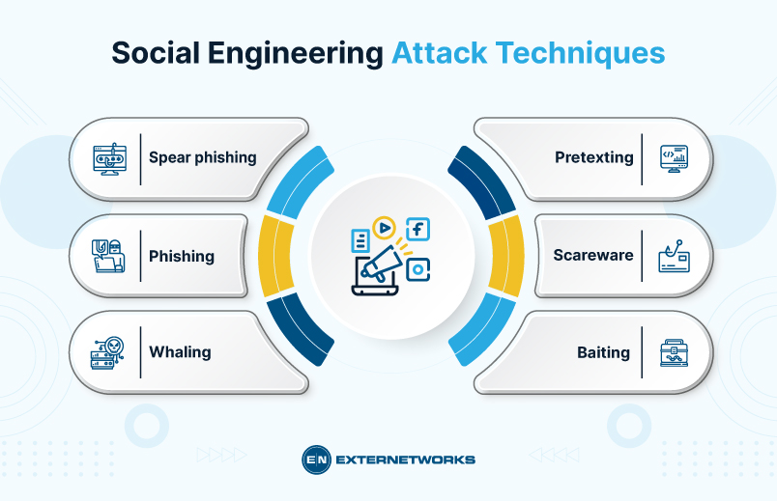

Slide 95
Lessons Learned
Objective: Improve future detection, prevention, and response capabilities to social engineering attacks.
Key Actions:
Post-Incident Review:
Conduct a post-mortem meeting with the Incident Response Team, HR, and any affected departments to evaluate the response.
Discuss what worked well (e.g., quick detection, effective employee reporting) and where improvements are needed (e.g., better phishing detection, faster containment).
Update Playbook:
Incorporate new Indicators of Compromise (IoCs) and best practices into the Social Engineering Playbook.
Update the incident response process to reflect any lessons learned, improving response time and effectiveness in future incidents.
Refine Tools and Processes:
Strengthen SIEM rules and email filtering systems to block future social engineering attempts earlier.
Conduct regular phishing simulation tests to ensure employees can identify and report phishing emails quickly.
Ongoing Employee Training:
Provide additional social engineering awareness training to all employees, focusing on identifying and responding to suspicious requests for information or access.

Slide 96
Conclusion
This Social Engineering Attack Playbook offers a comprehensive approach to managing and mitigating the risks posed by social engineering attacks, such as phishing, vishing, and pretexting. By focusing on preparation, employee training, and strong detection tools (like SIEM and email filtering), organizations can identify social engineering attempts early and respond quickly to contain and eradicate them.
Each phase of the playbook is designed to minimize the impact of social engineering attacks, ensuring that systems and data are protected. Lessons learned from each incident are incorporated to strengthen defenses and improve the organization's ability to respond to future attacks more effectively.

Slide 97

8:Brute Force Attack Playbook

Slide 98
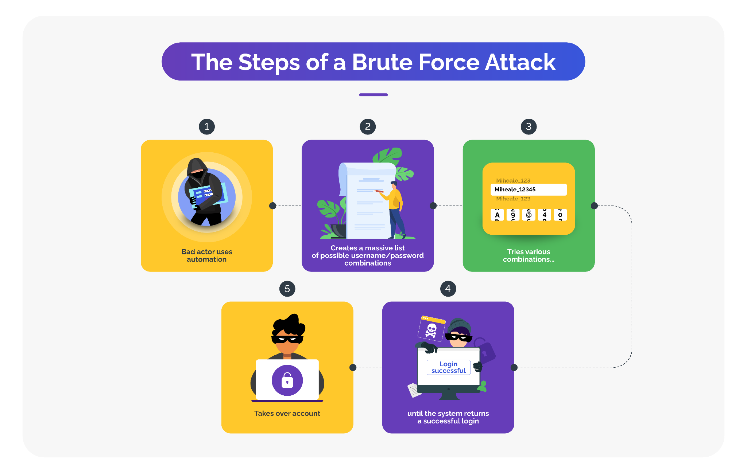

Slide 99
Phase 1: Preparation
Objective: Ensure the organization is equipped to detect and prevent brute force attacks.
Key Actions:
Incident Response Team (IRT): Define roles for handling brute force attacks, including IT, security analysts, and system administrators.
Access Controls and Authentication:
Implement multi-factor authentication (MFA) to reduce the impact of brute force attacks.
Enforce strong password policies requiring complex passwords and regular password updates.
Security Tools Setup:
Configure SIEM to monitor and alert on multiple failed login attempts, suspicious IP addresses, or login attempts from unusual locations.
Set up Intrusion Detection Systems (IDS) and Intrusion Prevention Systems (IPS) to detect and block brute force attempts.
Account Lockout Policies:
Implement an account lockout policy that temporarily disables accounts after a certain number of failed login attempts.
Employee Training:
Educate users on the importance of strong passwords and the risks of weak credentials, emphasizing the need for unique and complex passwords.

Slide 100
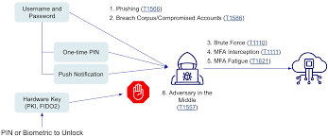

Slide 101
Phase 2: Detection & Analysis
Objective: Detect brute force attempts early and analyze the scope of the attack.
Key Actions:
Detection:
Use SIEM, IDS, and firewalls to monitor for:
Multiple failed login attempts from a single IP address or across multiple accounts.
Suspicious login patterns, such as many login attempts from different geographic locations in a short period.
Authentication failures exceeding normal thresholds.
Indicators of Compromise (IoCs) include:
Repeated failed login attempts from the same IP address or user account.
Account lockouts triggered by numerous failed login attempts.
Unsuccessful login attempts followed by successful logins from unfamiliar IP addresses.
Analysis:
Determine which accounts or systems are being targeted and assess the potential for compromise.
Identify whether the brute force attack is focused on one or multiple accounts.
Analyze the source of the attack (e.g., specific IP addresses, geographic regions) and check if they are known malicious actors.

Slide 102
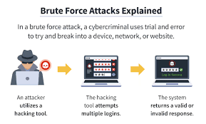

Slide 103
Phase 3: Containment, Eradication & Recovery
Objective: Stop the brute force attack, prevent unauthorized access, and restore normal operations.
Key Actions:
Containment:
Block IP addresses: Use firewall rules to block IP addresses or ranges involved in brute force attacks.
Enable account lockout: Ensure account lockout mechanisms are in place to limit the number of failed login attempts.
Rate limiting: Implement rate-limiting on login endpoints to reduce the speed at which attackers can attempt password combinations.
Alert affected users: Notify users whose accounts are being targeted and advise them to change passwords immediately if necessary.
Eradication:
Reset compromised credentials: If any accounts are compromised, force a password reset and require multi-factor authentication for re-entry.
Review and improve password policies: Ensure all users comply with strong password requirements and that compromised accounts adopt new, secure passwords.
Investigate attack origin: Trace back the source of the brute force attack to understand whether it was a targeted attempt or part of a larger automated campaign.
Recovery:
Re-enable locked accounts: Once the threat has been mitigated, carefully re-enable locked accounts and monitor for any further suspicious activity.
Ensure all systems are fully operational and that no unauthorized access occurred during the attack.

Slide 105
Phase 4: Post-Incident Activities
Objective: Strengthen authentication and monitoring measures to prevent future brute force attacks.
Key Actions:
Root Cause Analysis:
Determine how the brute force attack occurred (e.g., weak passwords, lack of account lockout policies, inadequate monitoring).
Assess whether any systems or accounts were compromised during the attack and how the attacker managed to bypass protections.
Strengthen Security:
Update firewall rules, SIEM alerts, and IDS/IPS configurations to detect brute force attacks earlier and block them before they escalate.
Implement additional multi-factor authentication (MFA) for all high-privilege accounts and sensitive systems.
Enforce more stringent password policies and periodic password changes across the organization.
Enable captchas or additional user verification for login attempts to reduce automated attack success rates.
Incident Reporting:
Document the incident, including details about the attack, its impact, and how it was mitigated.
Report the incident to senior management and other relevant stakeholders to ensure that the response is fully documented.

Slide 106
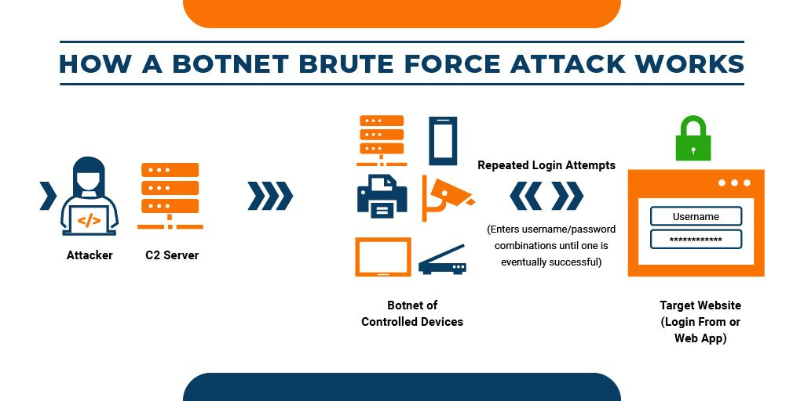

Slide 107
Lessons Learned
Objective: Use the incident as an opportunity to improve authentication, detection, and response to future brute force attacks.
Key Actions:
Post-Incident Review:
Hold a post-mortem meeting with the Incident Response Team and IT security staff to evaluate how effectively the attack was handled.
Discuss what went well (e.g., detection speed, account lockouts) and what could be improved (e.g., better monitoring, faster containment).
Update Playbook:
Revise the Brute Force Attack Playbook to include new Indicators of Compromise (IoCs), improved response steps, and lessons learned from the attack.
Update the SIEM rules and firewall configurations based on the characteristics of the attack.
Refine Tools and Processes:
Improve detection systems, such as enhancing SIEM alert thresholds to detect brute force attacks earlier.
Regularly review and test account lockout policies, rate limiting, and other controls to ensure they work effectively.
Ongoing Employee Training:
Provide additional training for employees on how to create strong passwords and avoid common password pitfalls (e.g., reusing passwords, using easily guessable ones).
Conduct phishing tests and security awareness programs to ensure employees are vigilant against attacks targeting weak credentials.

Slide 108
Conclusion
This Brute Force Attack Playbook provides a structured approach to handling brute force attacks, emphasizing the importance of strong password policies, multi-factor authentication (MFA), and real-time detection through tools like SIEM and IDS/IPS. By ensuring robust account protection and rapid response mechanisms, organizations can mitigate the risks posed by brute force attempts.
Each phase focuses on early detection, immediate containment, and strengthening defenses to prevent future attacks. Lessons learned from the incident are used to update security protocols and improve the organization’s ability to detect, prevent, and respond to brute force attacks effectively

